Slide 1
Azure Data Factory
Kamil Dworak
Tomasz Krawczyk

Slide 2
Agenda
ETL vs ELT – quick overview
Azure Data Factory
Pipelines,
Actions
Linked Services
Datasets
Triggers
Monitoring
Notes:
I my zeby tak gwaltownie niezaczac

Slide 3
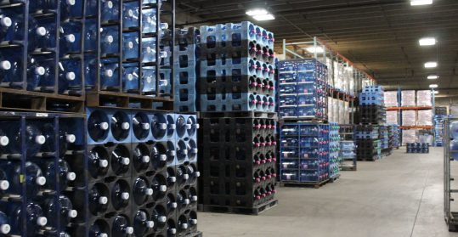

ETL vs ELT
ETL (Extract Transform Load) - Schema On-Write
Data Warehouse
ELT (Extract Load Transform) - Schema On-Read
Data Lake
Source: https://premiumwaters.com
What is Data Lake ?
“If you think of a datamart (a subset of a data warehouse) as a store of bottled water – cleansed and packaged and structured for easy consumption – the data lake is a large body of water in a more natural state„
Pentaho CTO James Dixon
I(ngest) S(tore) A(nalyse) S(urface) A(ct)
Source :https://snowbrains.com

Slide 4
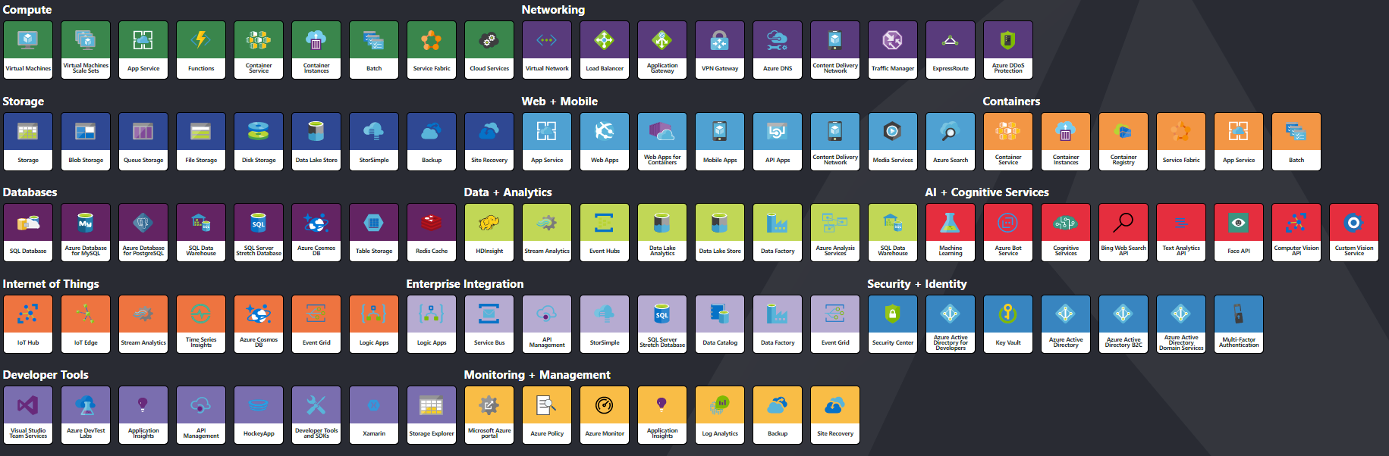
More than 100 Services on Azure
http://azureinteractives.azurewebsites.net/Azure101Cards/default.html

Slide 5
Data Integration - What we have?
SSIS –SQL Server Integration Services
Part of SQL Server (Data Factory V2)
ETL to/from SQL Service
Rich designer (and other tools e.g. BIML)
Azure Feature Pack for Integration Services
Azure Data Factory

Slide 6
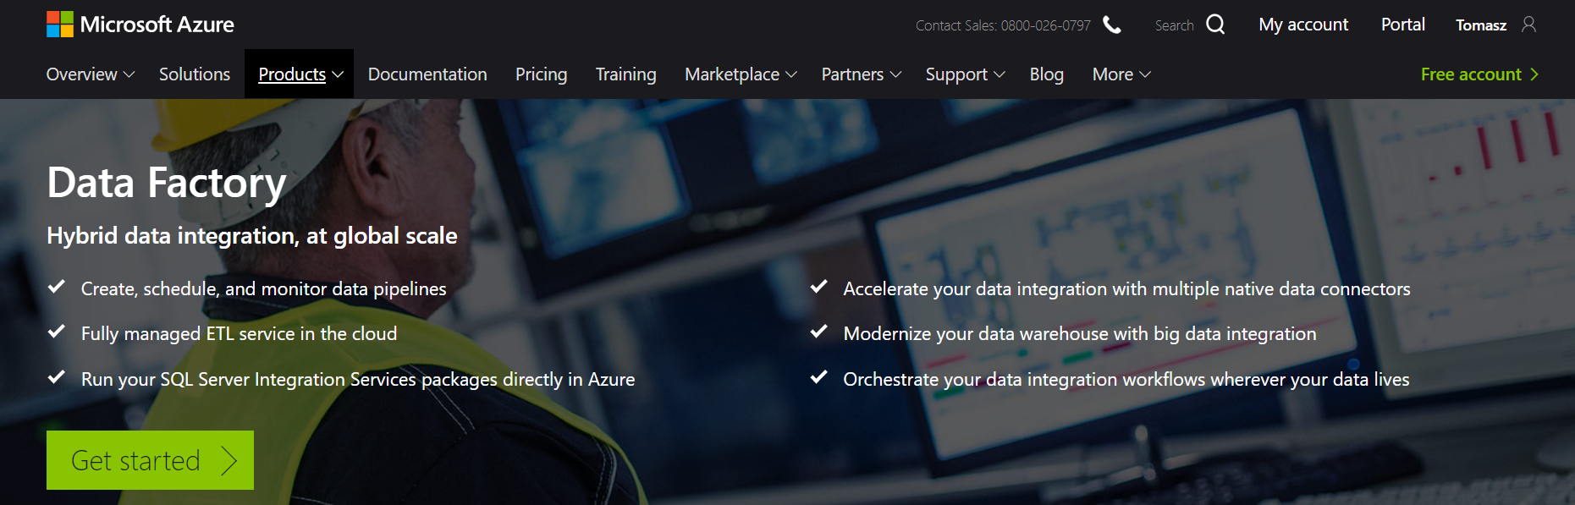
Azure Data Factory (V2)
https://azure.microsoft.com/en-us/services/data-factory/
Notes:
Fully managed service to support orchestration of data movement and transformation
Connect to relational or non-relational data that is on-premises or in the cloud
Allows monitor and manage data processing pipelines
Version 1 and 2 (+SSIS)

Slide 7
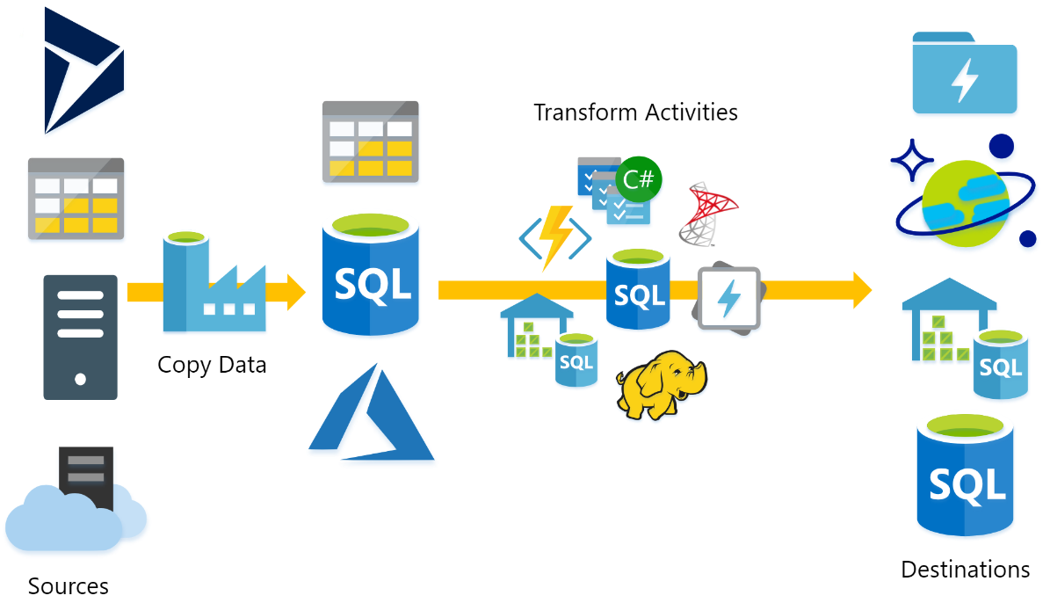
What does ADF do?
Source : P.Andrew

Slide 8
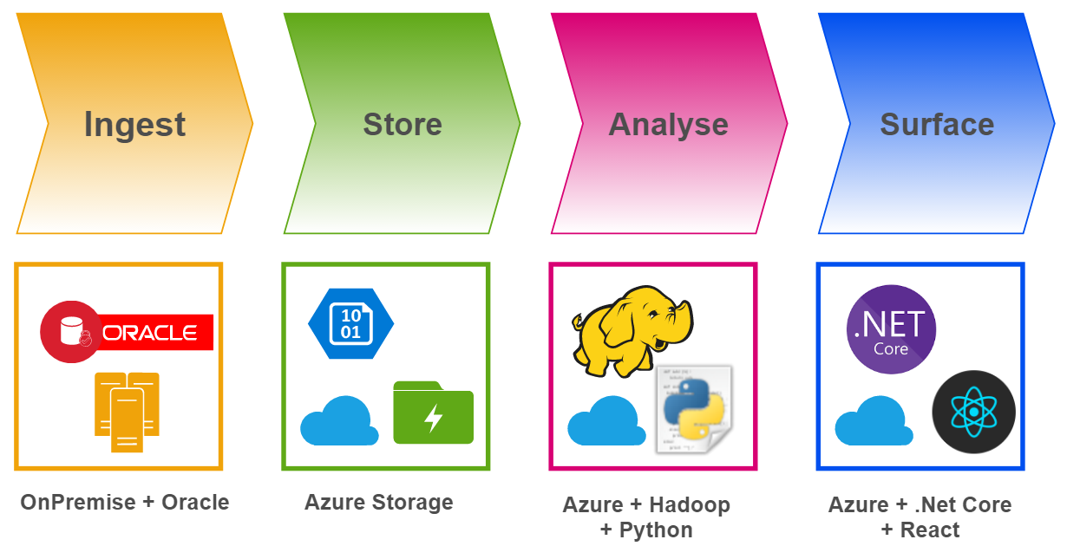
Big Data Project – Basic Concept

Slide 9
DEMO/TASK
Creating and configuring Azure Services

Slide 10

Azure Data Factory Concept
Dataset
(eg. tables, files)
Activity
(eg. Copy, Hive job,
SP, ADLA job)
Pipeline
(schedule,monitor,
manage)
Consumes
Is a
logical
grouping of
Produces
Represents
data item(s)
stored in
Runs on
Linked Services
(eg. SQL Server,
HDInsight,ADLA)
Triggers
Notes:
Activities
Actions you perform on your data
Inputs turned into outputs
Pipelines
Logical grouping of activities for group operations
Data sets
A named reference/pointer to data you want to use as an input or output of an activity
Linked services
Connection of data factories to the resources and services you want to use
Connection of data stores like Azure storage and on-premises SQL Server
Connection of compute services like Azure Machine Learning, Azure HDInsight, and Azure Batch

Slide 11
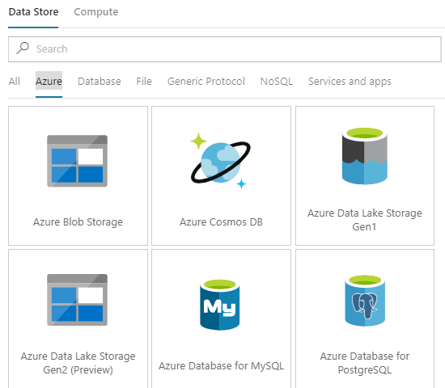
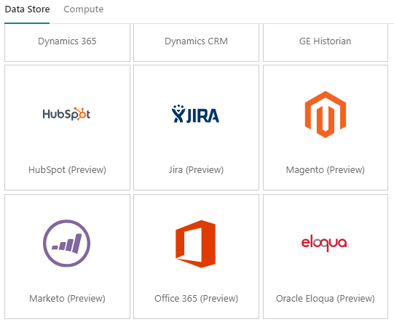
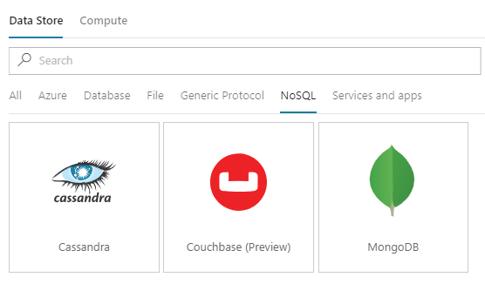
Azure Data Factory – Linked Services
More than 70 connectors

Slide 12
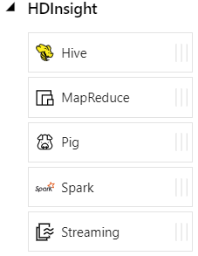
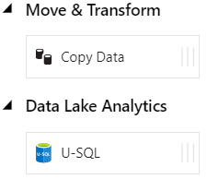
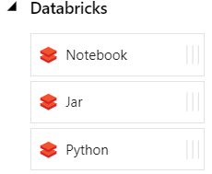
Azure Data Factory - Data activities
Data movement activities : Copy Activity
Data transformation activities :
HDInsight (Hive, Pig, MapReduce ,Hadoop Streaming ,Spark)
Azure Databricks Notebooks, Jars, Pythons
Machine Learning activities: Batch Execution and Update Resource (*)
Stored Procedure
Data Lake Analytics U-SQL
DotNet (Custom)

Slide 13
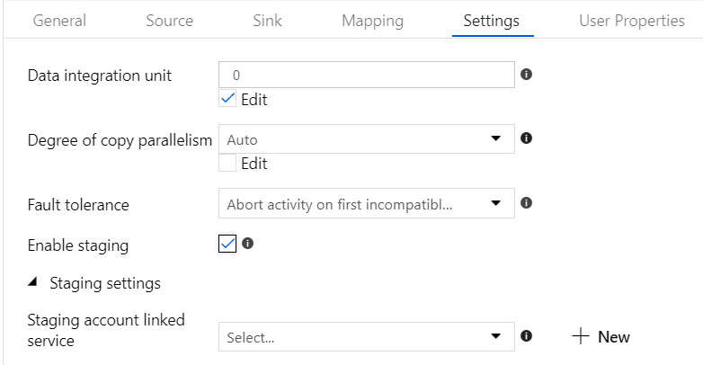
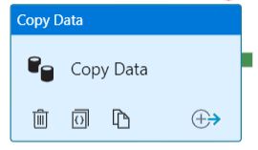
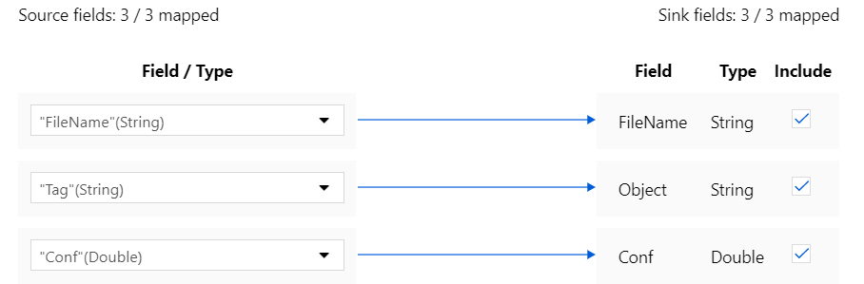
Azure Data Factory – Copy Activity

Slide 14
DEMO/TASK
Creating simple copy activity

Slide 15
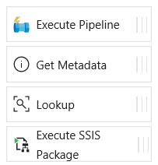
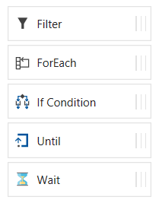
Azure Data Factory - Control flow activities
Execute Pipeline Activity
ForEach Activity
Web Activity
Lookup Activity
Get Metadata Activity
Until Activity
If Condition Activity
Wait Activity

Slide 16
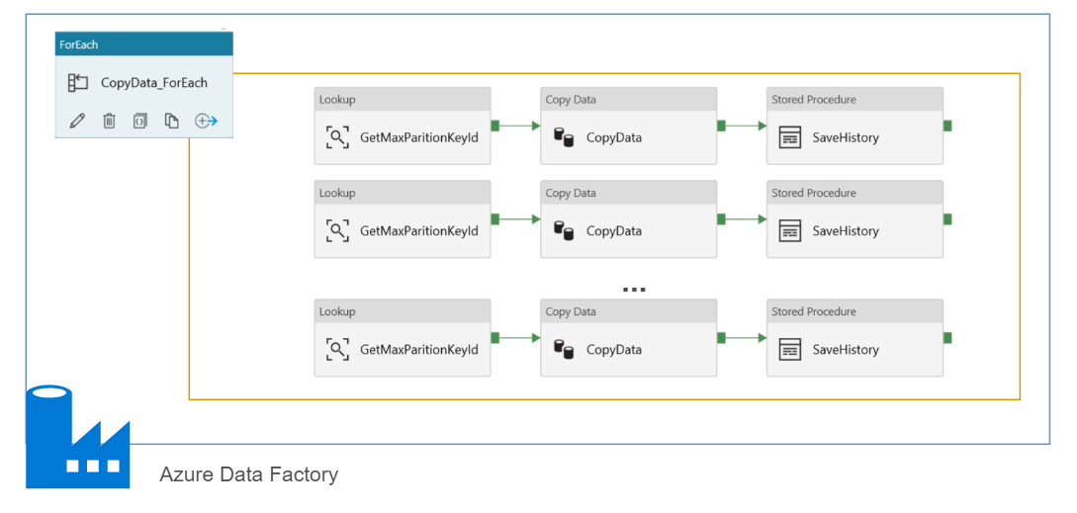
Azure Data Factory – ForEach
Max 20 DOP

Slide 17
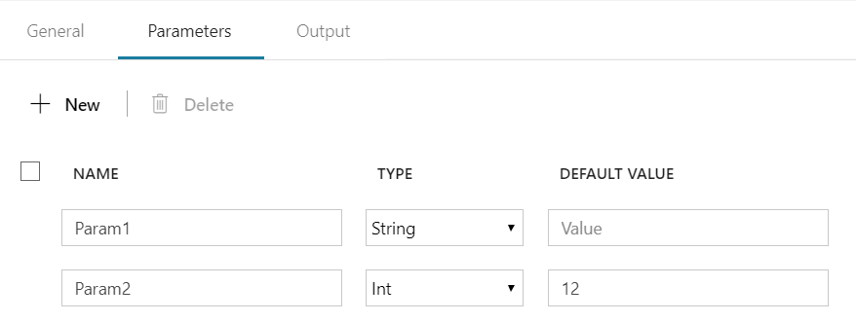
Azure Data Factory – Parameters
Parameters - are key-value pairs of read-only configuration settings that are defined in pipelines
Name, Type, Default Value
@pipeline().parameters.Param1
@pipeline().parameters.Param1

Slide 18
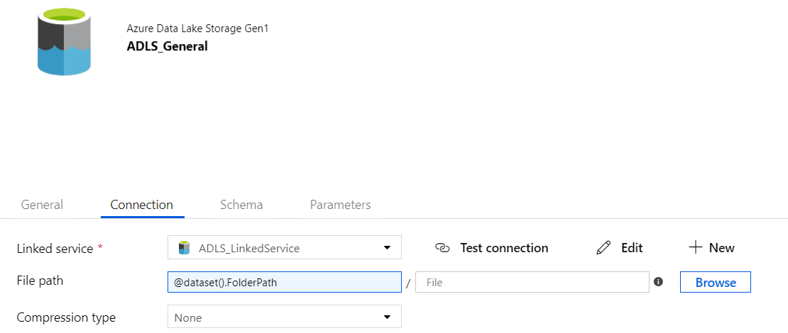
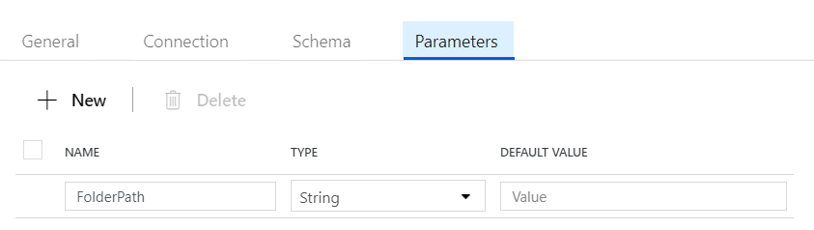
Azure Data Factory – Datasets Parameters

Slide 19
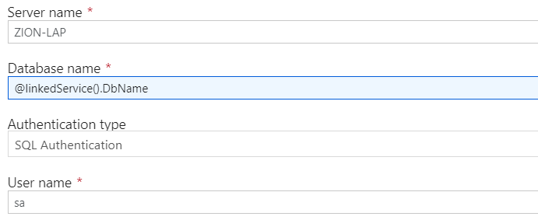
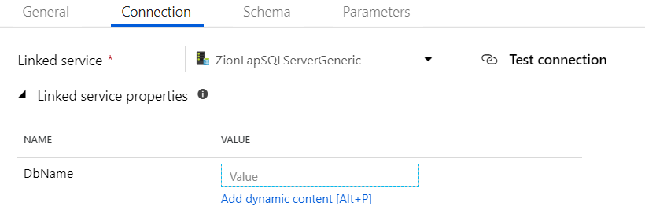
ADF – Linked Services Parameters

Slide 20
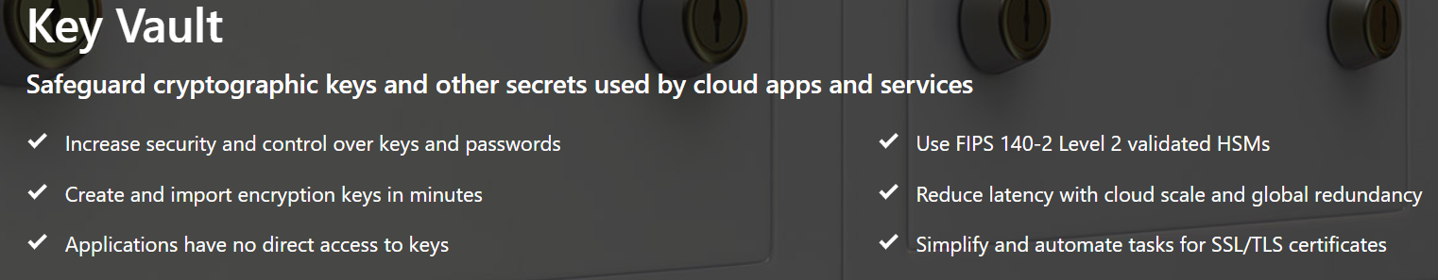
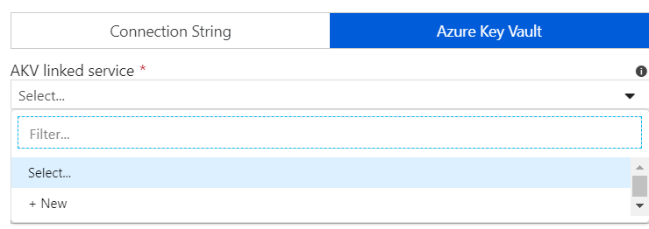

ADF – Linked Services Azure Key Vault

Slide 21
ADF – Variables
Pipeline scope (System):
@pipeline().DataFactory
@pipeline().Pipeline
@pipeline().RunId
@pipeline().TriggerType
@pipeline().TriggerId
Trigger scope(System):
@trigger().scheduledTime
@trigger().startTime
User pipeline scope Variables
Set Variable Activity
Append Variable Activity

Slide 22
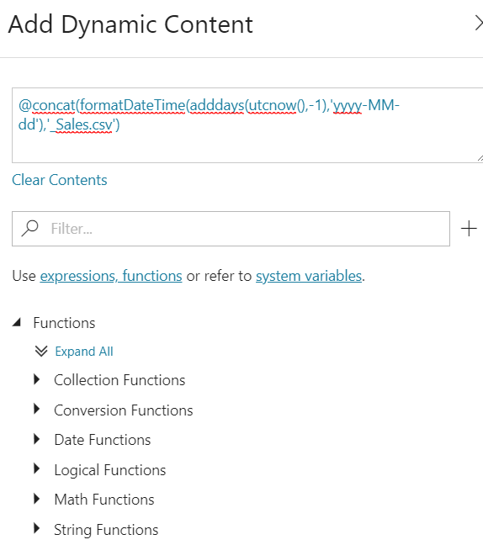
ADF – Expressions and Functions
Expressions
Dynamic Content
Functions
String functions
Collection functions
Logical functions
Conversion functions
Math functions
Date functions

Slide 23
ADF– Branching
Branching
On success
On failure
On completion
Activity 2
On success
Activity 1
(eg. Copy, Hive job,
SP, ADLA job)
Activity 3
On completion
On failure
Activity 4

Slide 24
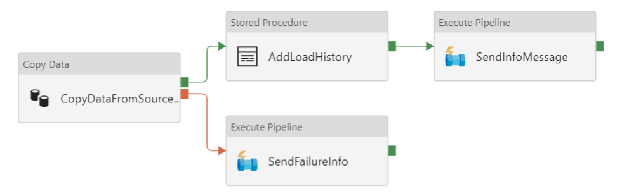
ADF –Branching

Slide 25
DEMO/TASK
Triggers
Scheduler

Slide 26
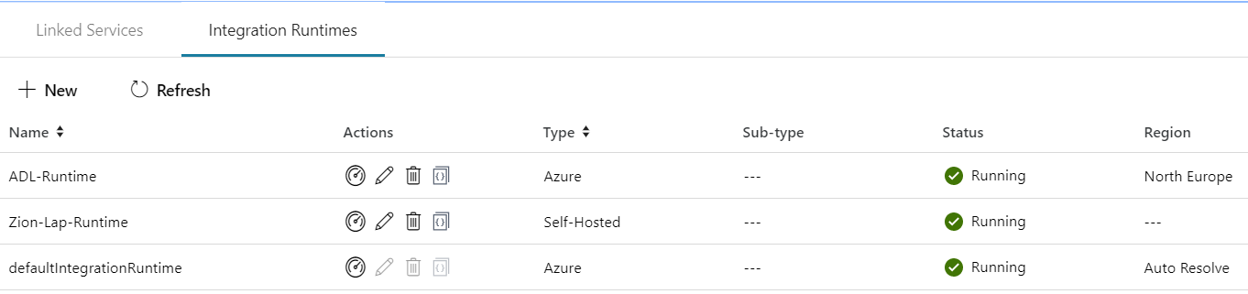
Integration runtime(s) in Azure Data Factory
The Integration Runtime (IR) is the compute infrastructure used by Azure Data Factory to provide the following data integration capabilities across different network environments
Integration runtime types:
Azure (Data movement and activity on Azure)
Self-hosted (Data movement and activity dispatch between public and private network)
Azure-SSIS (SSIS package execution)

Slide 27


Self Hosted Integration runtime
Now called Self Hosted Integration Runtime
Before Data Management Gateway
One version for ADF V1 and V2
SSL Port : 443
One to Many

Slide 28
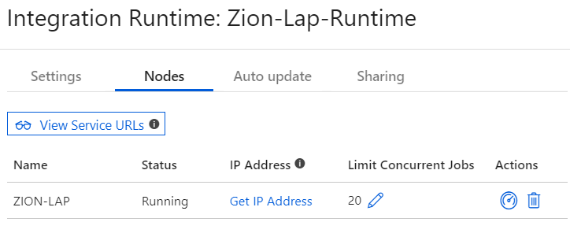
Self Hosted Integration runtime

Slide 29
DEMO/TASK
Self Hosted Integration Runtime

Slide 30
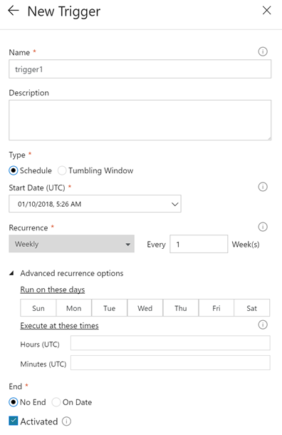
Pipeline execution and triggers in Azure Data Factory
Manual execution (on-demand)
The REST API
The .NET SDK
Trigger execution
Schedule trigger
Tumbling window trigger

Slide 31
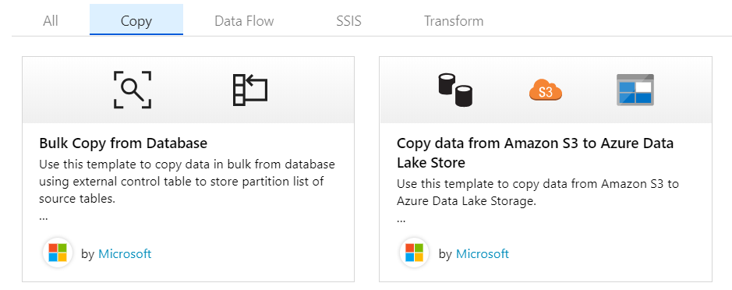
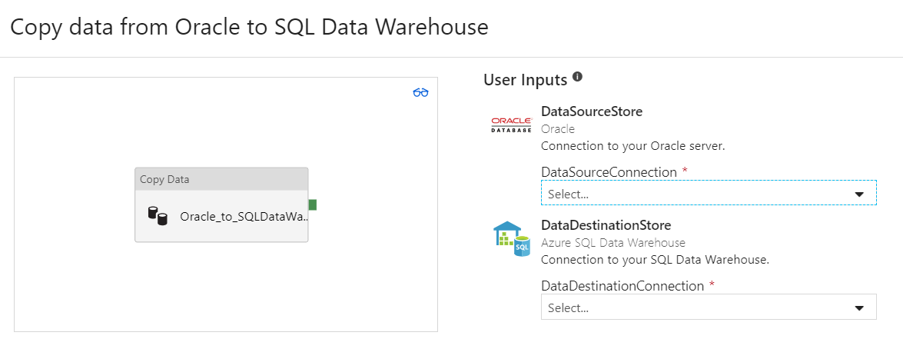
ADF -Templates

Slide 32
DEMO/TASK
Image Processing
Parking Data Processing

Slide 33
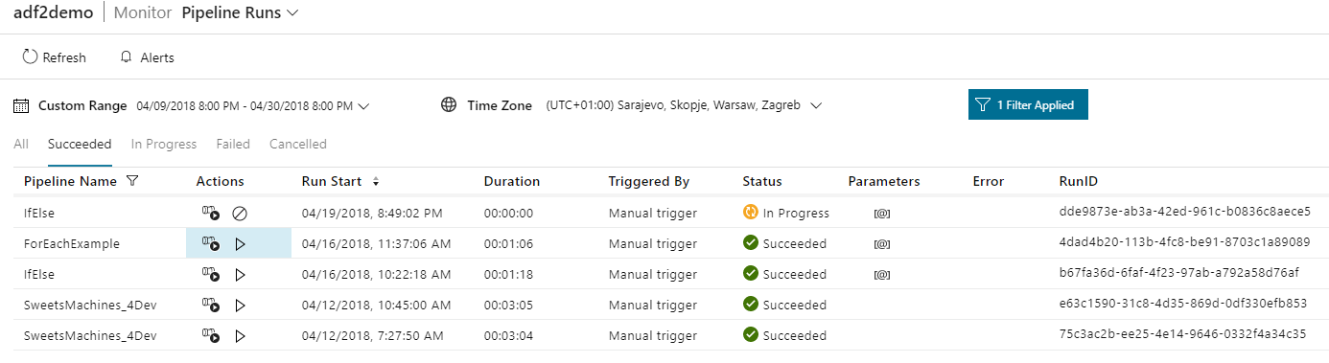
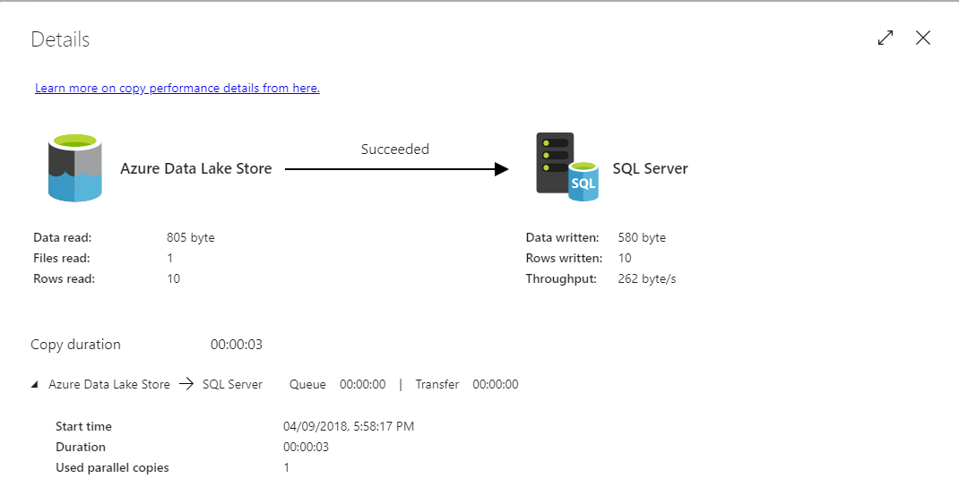
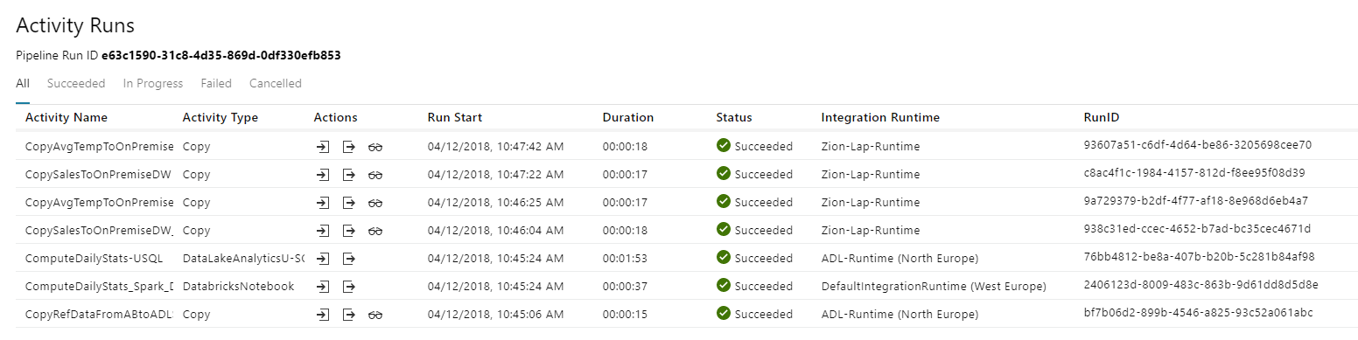
Azure Data Factory Monitoring

Slide 34
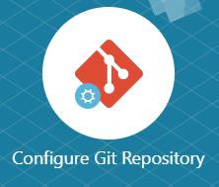
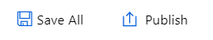
Azure Data Factory Source Control
Visual Studio Team Services (Azure Portal)
Import/Export ARM Templates
GitHub

Slide 35
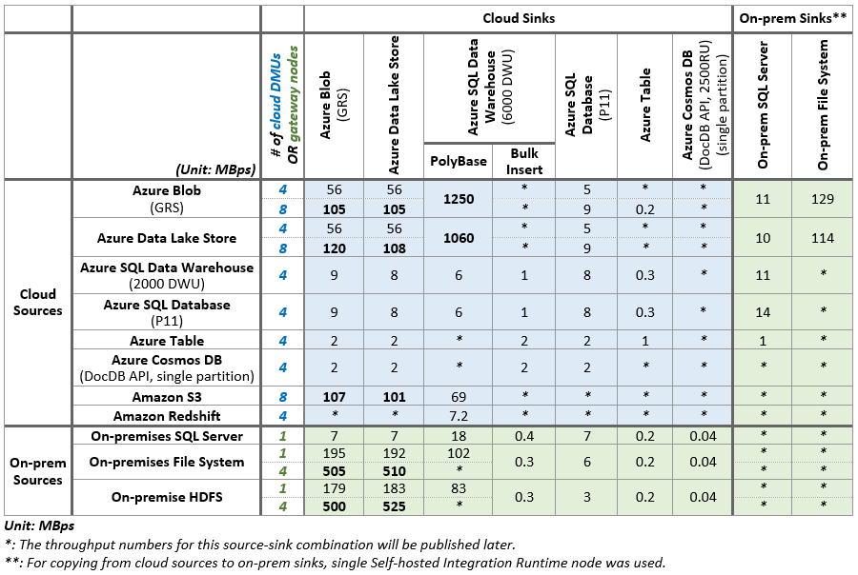
Azure Data Factory Performance
https://docs.microsoft.com/en-us/azure/data-factory/copy-activity-performance

Slide 36
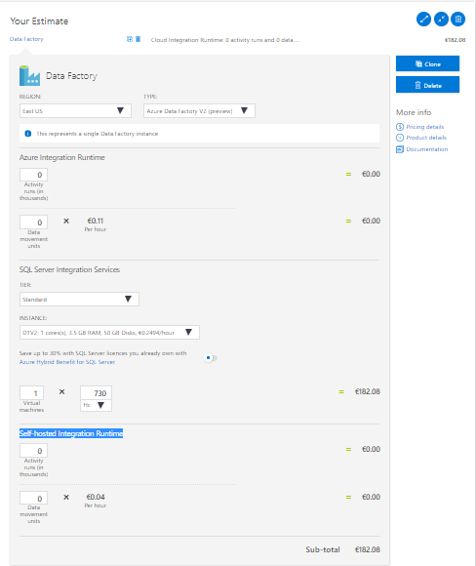
Azure Data Factory Costs
Costs depend on Integration Runtime:
Azure Integration Runtime
Activity runs (in thousands)
Data movement units
Self-hosted Integration Runtime
Activity runs (in thousands)
Data movement units
SQL Server Integration Services
Virtual machine(s) type e.g. D1V2 (h)
https://azure.microsoft.com/en-gb/pricing/calculator/

Slide 37

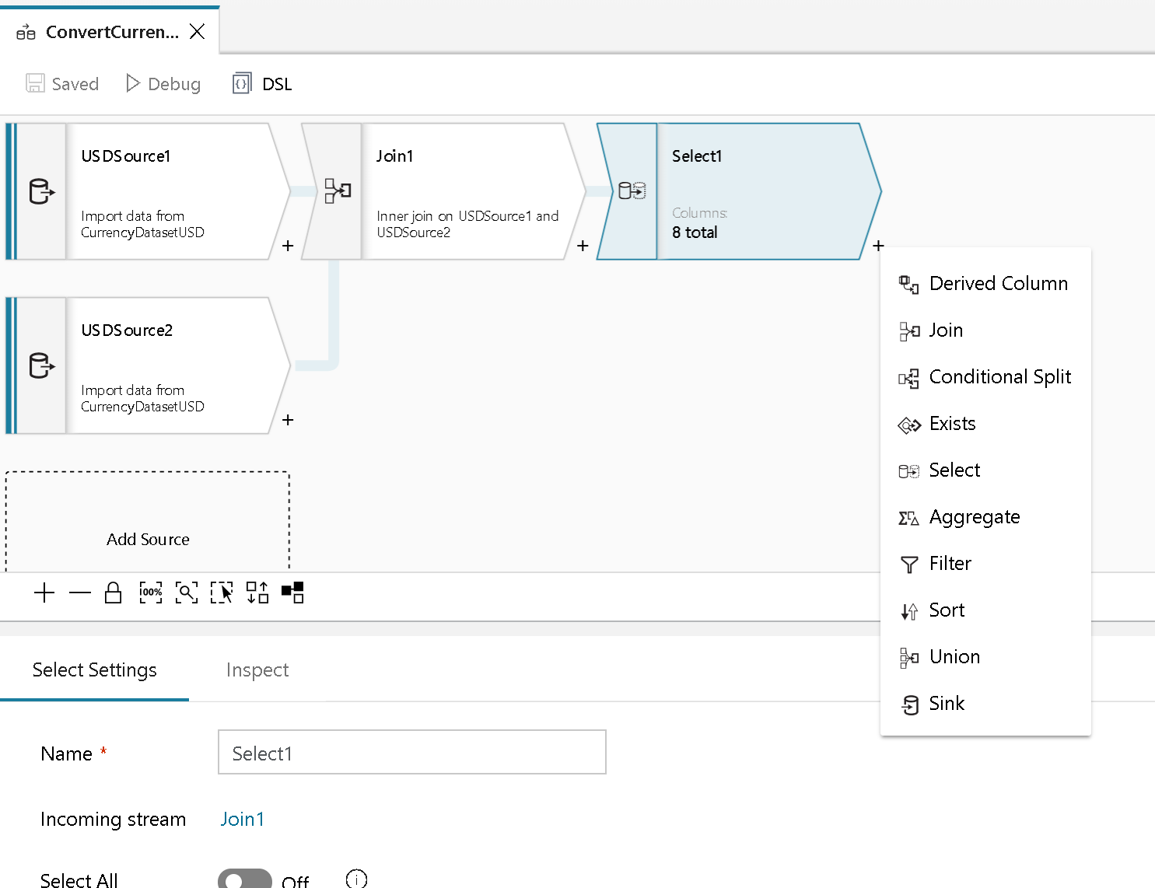
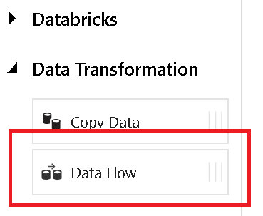
ADF - Data Mapping Flow (Preview)
+
Azure Data Factory
Azure Databricks

Slide 38
DEMO
Monitoring

Slide 39
Q & A

Slide 40
THANK YOU!

